Slide 1
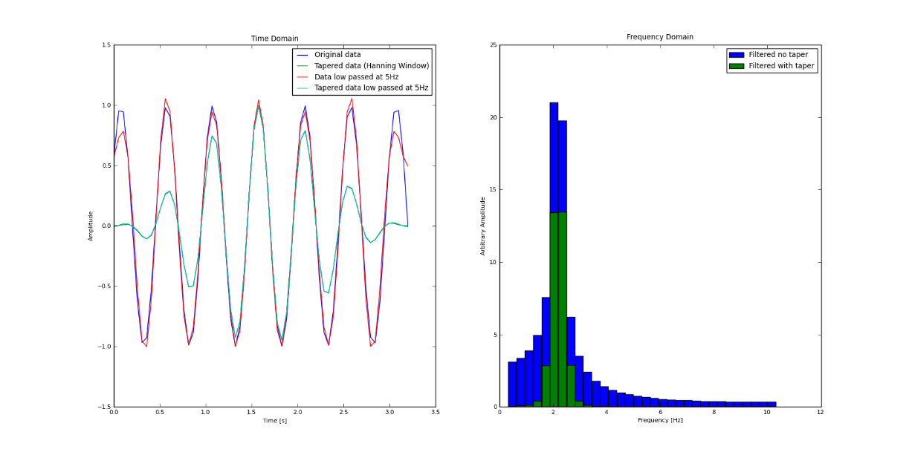
Spectral Estimation: Applications in Seismology
Estimation of spectra
windowing
resampling
Seismograms – frequency content
Spectral estimation
Eigenmodes of the Earth
„Seismo-weather“ with FFTs
Scope: Understand how to estimate the spectrum from time series and interpret both phase and amplitude part. Learn other applications of the FFT in seismology

Slide 2
Phase and amplitude spectrum
The spectrum consists of two real-valued functions of angular frequency, the amplitude spectrum mod (F(ω)) and the phase spectrum φ(ω)
In many cases the amplitude spectrum is the most important part to be considered. However there are cases where the phase spectrum plays an important role (-> resonance, seismometer)

Slide 3
Before estimating a spectrum you have to preprocess your data!!!!

Slide 4
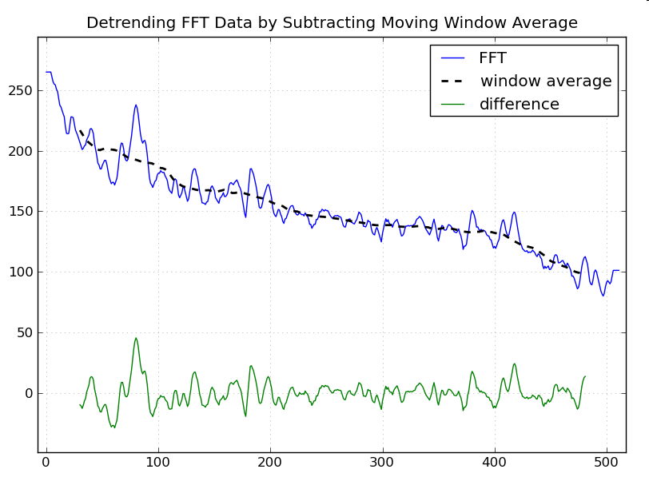
Detrending - Example
Source: swharden.com

Slide 5
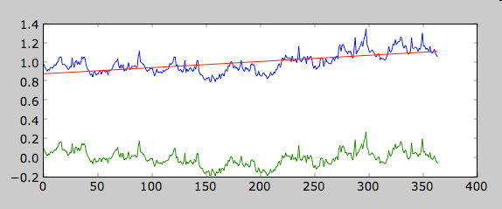
Detrending - Example

Slide 6
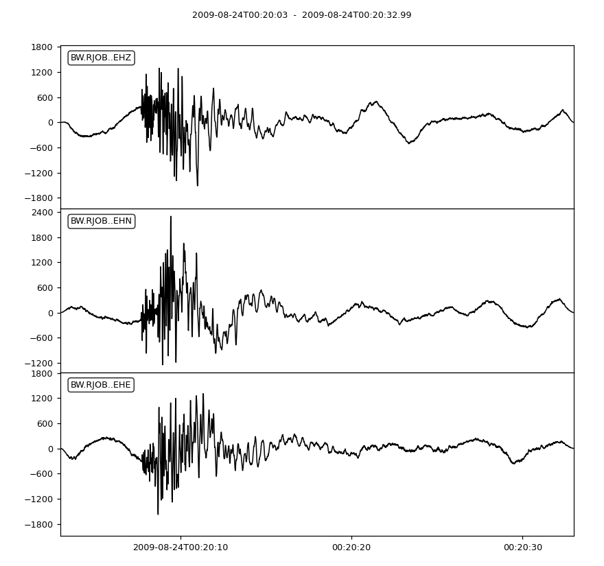
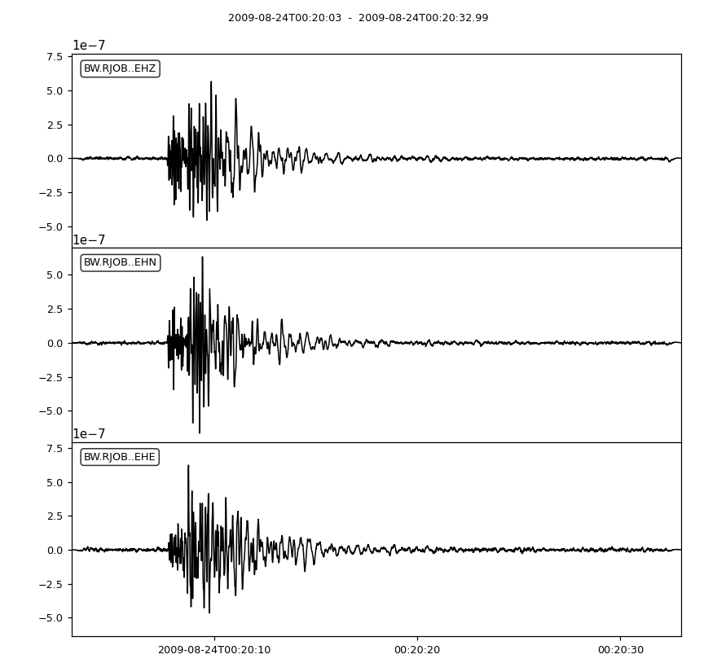
Demeaning/Detrending
Before
After

Slide 7
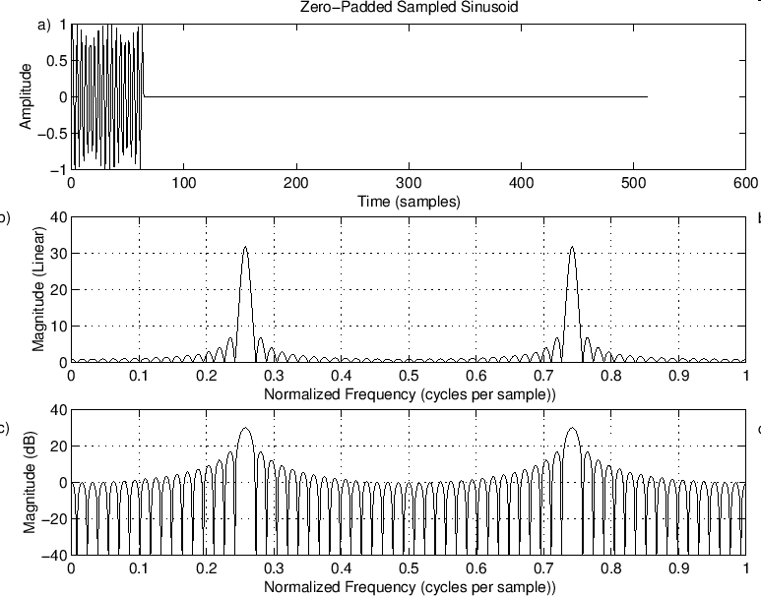
zero - padding
zero padding in the time domain corresponds to ideal interpolation in the frequency domain

Slide 8
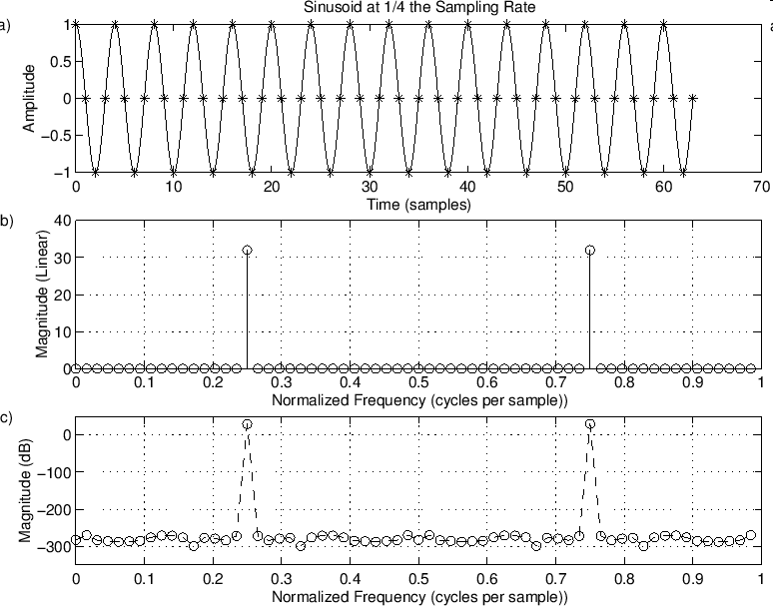
Some examples

Slide 9
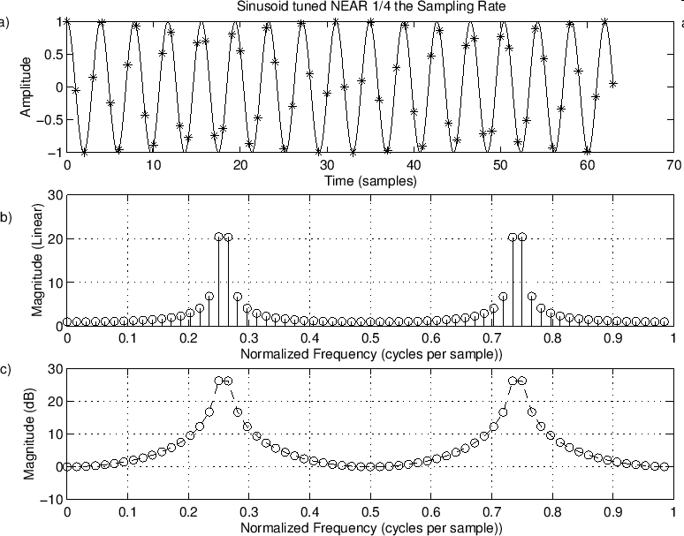

Slide 10

Spectral leakage

Slide 11
Windowing/Tapering

Slide 12
Simple rules
Add as many zeros as possible!
Select a fine enough sampling interval, stay away from Nyquist! (no problem with periodicity …)
Use Window functions (tapers) … more on that later

Slide 13
Jupyter Notebooks
04 Programming exercise (change functions, add phase)

Slide 14
Energy and power spectra (random signals)
The theorem by Parseval states the preservation of energy
Interpretation: The sum of the squared amplitude is the total energy of the system, thus |h(t)|² in the integral is the power and consequently |H(ω)|² is the power spectral density (PSD) if it is normalized by the signal duration T:
Careful: different normalizations exist (e.g., psd in Matlab)

Slide 15
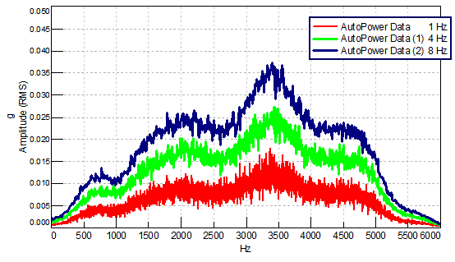
Power Spectral Density (psd)
Source: https://community.sw.siemens.com/s/article/what-is-a-power-spectral-density-psd

Slide 16
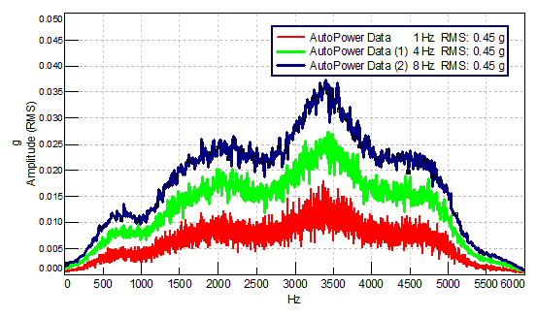
Power Spectral Density

Slide 17
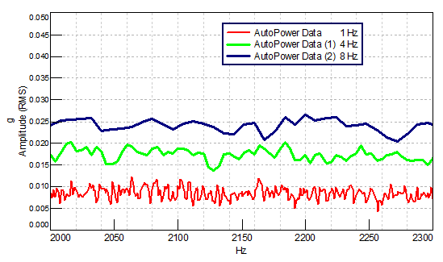
Power Spectral Density

Slide 18
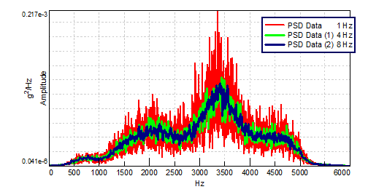
Power Spectral Density

Slide 19
Low Noise Model Earth

Slide 20
Exercise
05 Power Spectral Density

Slide 21
Applications in seismology:
Spectral estimation

Slide 22
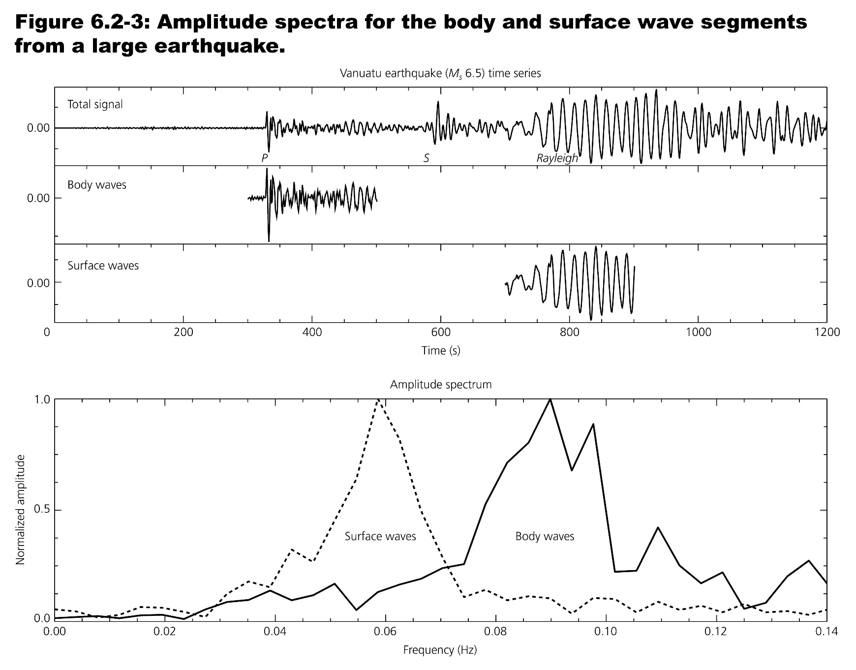
Frequencies in seismograms

Slide 23
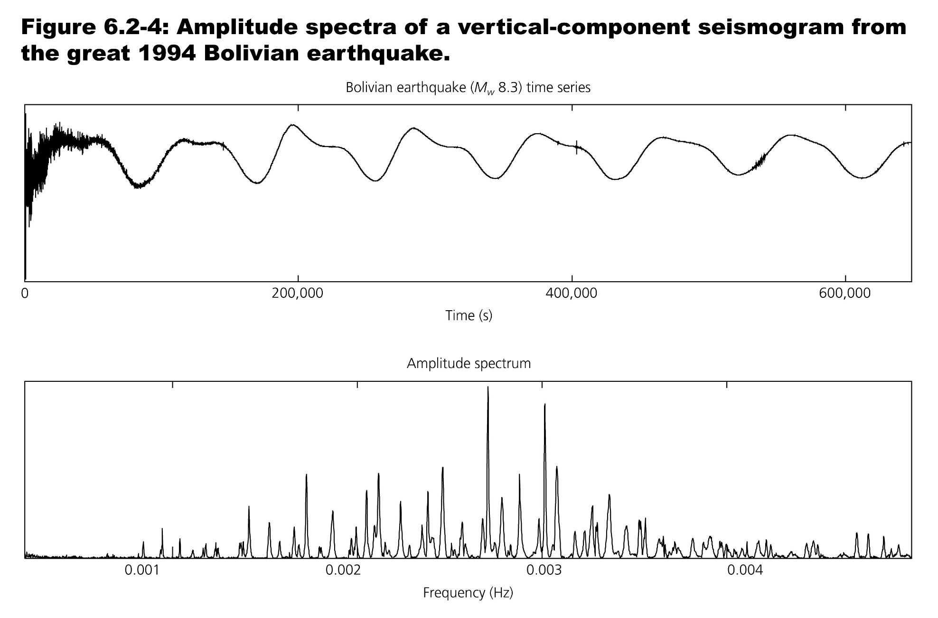
Amplitude spectrum Eigenfrequencies

Slide 24
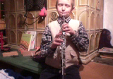
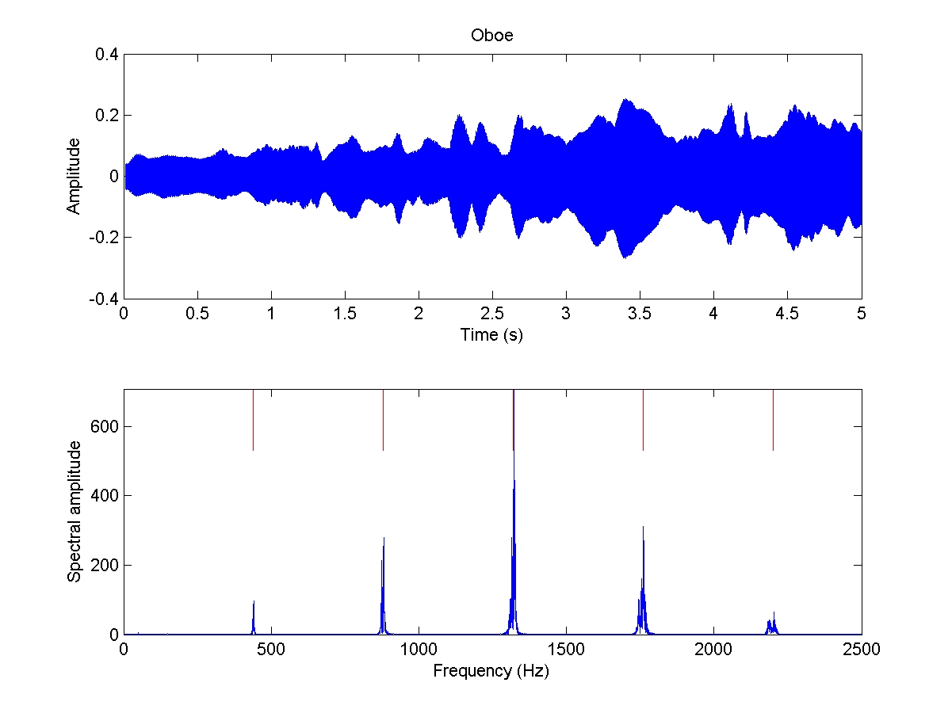
Sound of an instrument
a‘ - 440Hz

Slide 25
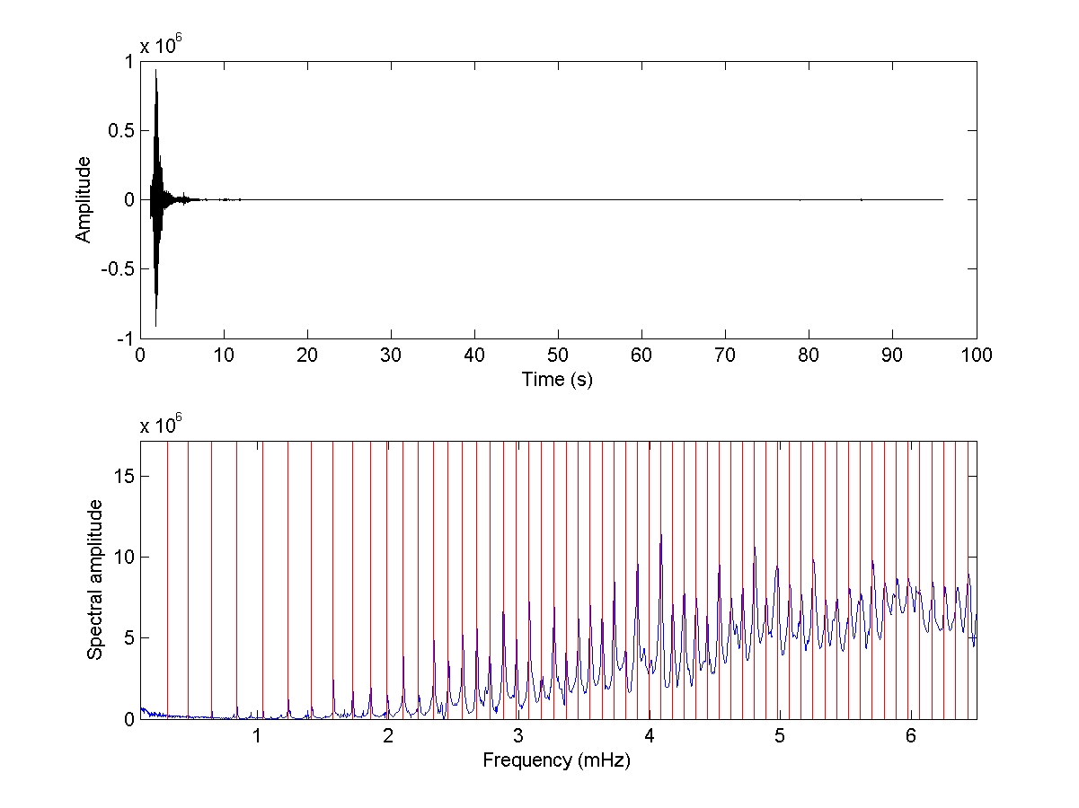
Instrument Earth
26.-29.12.2004 (FFB )
₀S₂ – Earth‘s gravest tone
T=3233.5s =53.9min
Theoretical eigenfrequencies

Slide 26
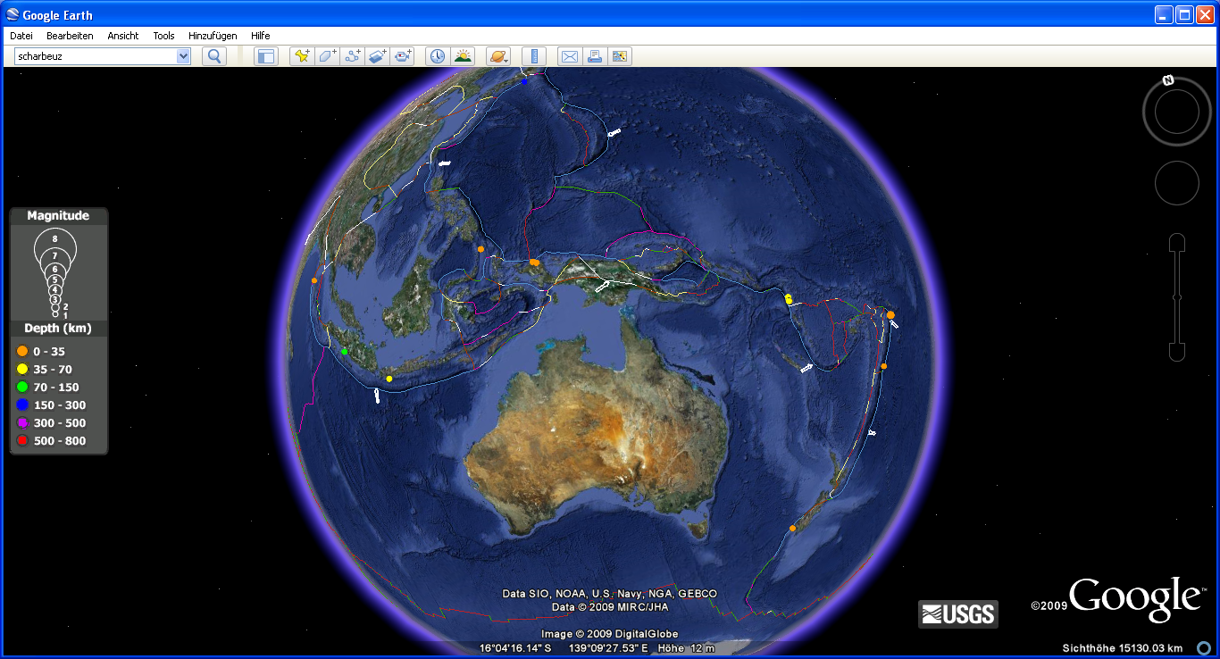
The 2009 earthquake „swarm“

Slide 27
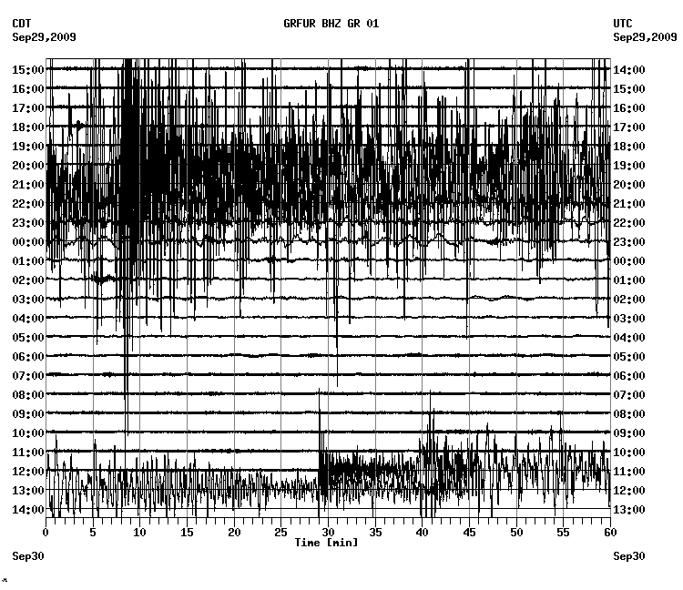

Slide 28
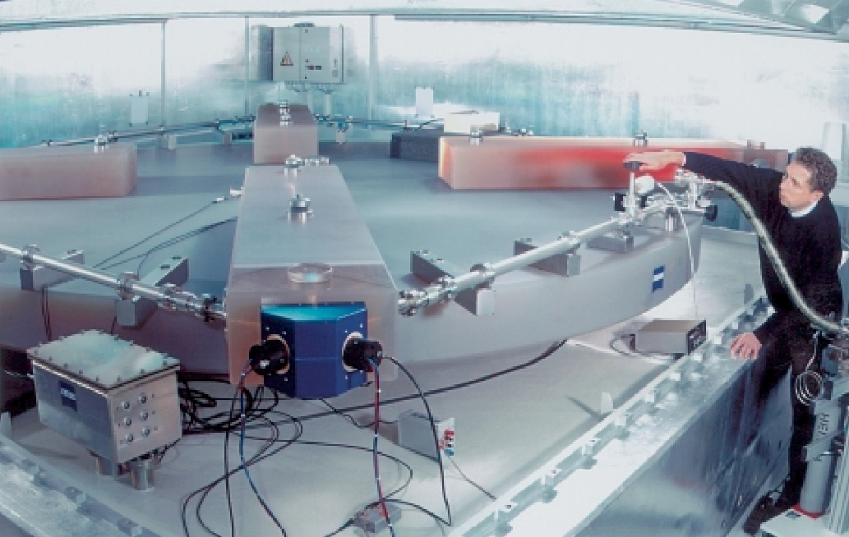
Rotations …

Slide 29
First observations of eigenmodes with ring laser!

Slide 30
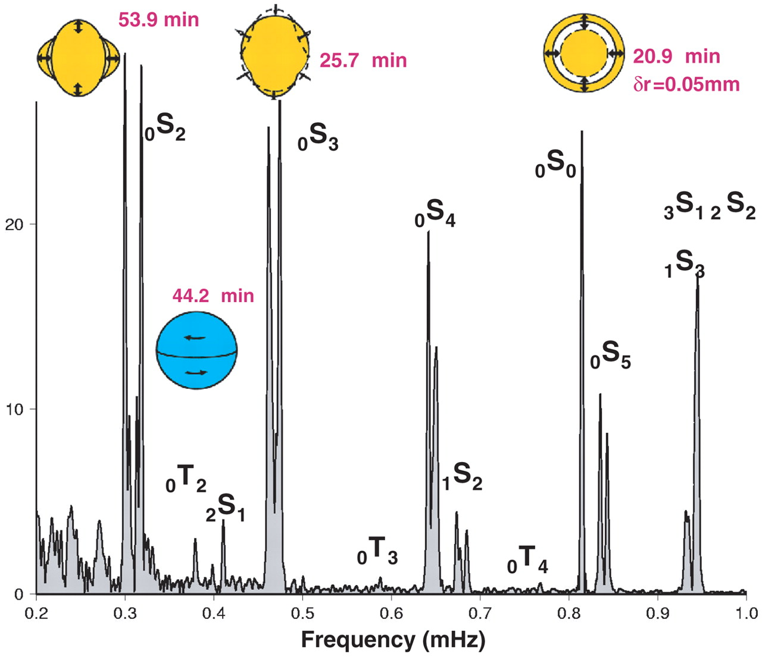
Programming Exercise
Jupyter Notebook
Spectral Estimation - Earth‘s Free Oscillations

Slide 31
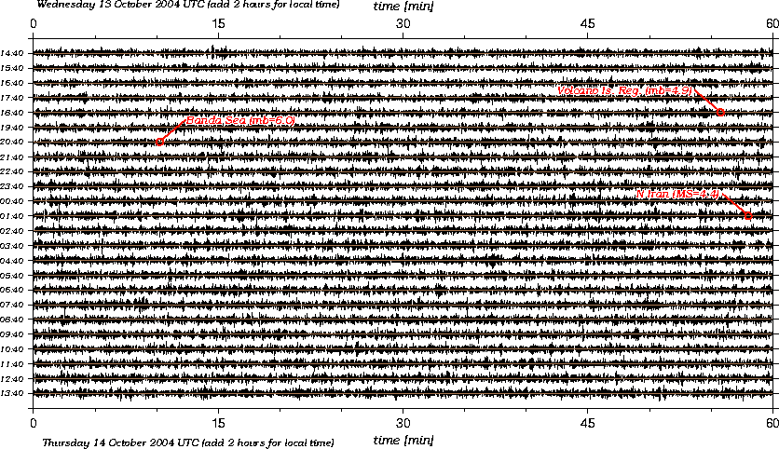
Spectral analysis: windowed spectra
24 hour ground motion, do you see any signal?

Slide 32
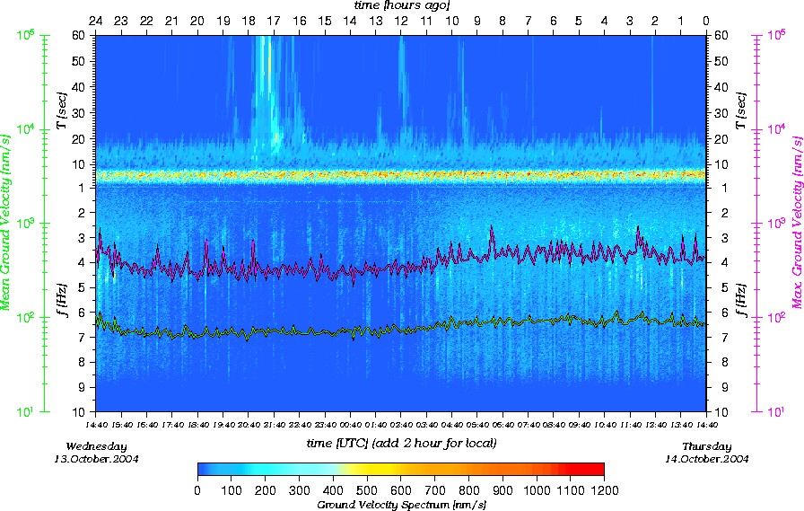
Seismo-“weather“
Running spectrum of the same data

Slide 33
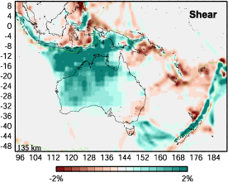
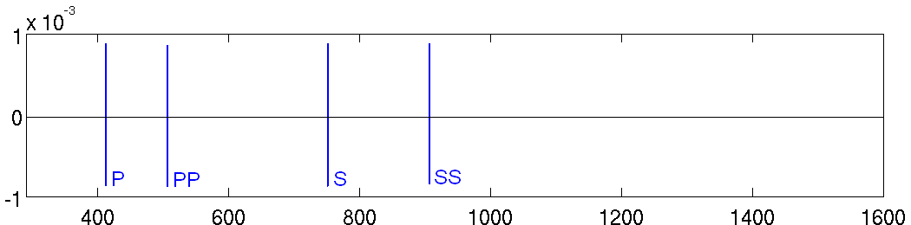
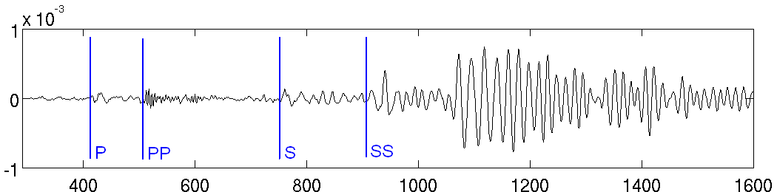
Going beyond ray tomography …
Western Samoa, 1993/5/16, D=34.97°
V_{z} [m/s]
Shear wave speed variations
Gorbatov & Kennett (2003)
t [s]
Western Samoa, 1993/5/16, D=34.97°
?
V_{z} [m/s]
t [s]

Slide 34
Time-frequency representation of seismograms comparing data with synthetics
Kristeková et al., 2006 : ... the most complete and informative characterization of
a signal can be obtained by its decomposition in the time-frequency plane ... .
[ t-w representation of synthetics, u(t) ]
[ t-w representation of data, u₀(t) ]
… an elegant way of separating phase (i.e., travel time) and amplitude (envelope) information!
Notes:
A very elegant way of doing this was proposed by Kristeková et al., who stated that „the most complete and informative characterization of a signal can be obtained by ist decomposition in the time-frequency plane.“ This time-frequency representation of a time series u(t) is simply a windowed Fourier transform with a sliding Gaussian window g(t). The more technical term for this is the Gabor transform. We apply this transform to both the data and the synthetics and thus obtain the respective time evolutions of the phase and the envelope.

Slide 35
Time-frequency misfits ... individually weighted …

Slide 36
Programming Exercises
07 Time frequency analysis

Slide 37
Good practice – for estimating spectra
Filter the analogue record to avoid aliasing
Digitise such that the Nyquist lies above the highest frequency in the original data
Window to appropriate length
Detrend (e.g., by removing a best-fitting line)
Taper to smooth ends to avoid Gibbs
Pad with zeroes (to smooth spectrum or to use 2^{n} points for FFT)

Slide 38
Good practice - Resampling (Decimating)
Often it is useful to down-sample a time series (e.g., from 100Hz to 1Hz, when looking at surface waves).
In this case the time series has to be preprocessed to avoid aliasing effects
All frequencies above twice the new sampling interval have to be filtered out

